Slide 1
Loyalty Awardees
December 6, 2022

Slide 2
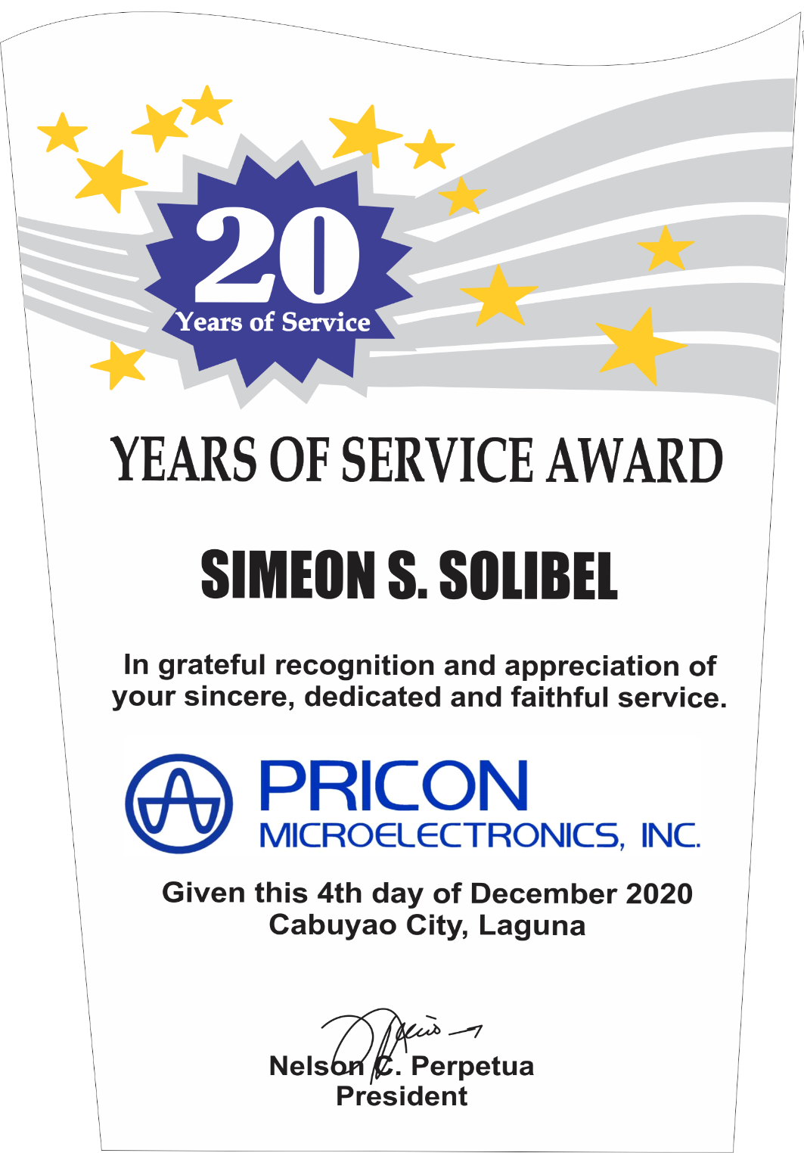
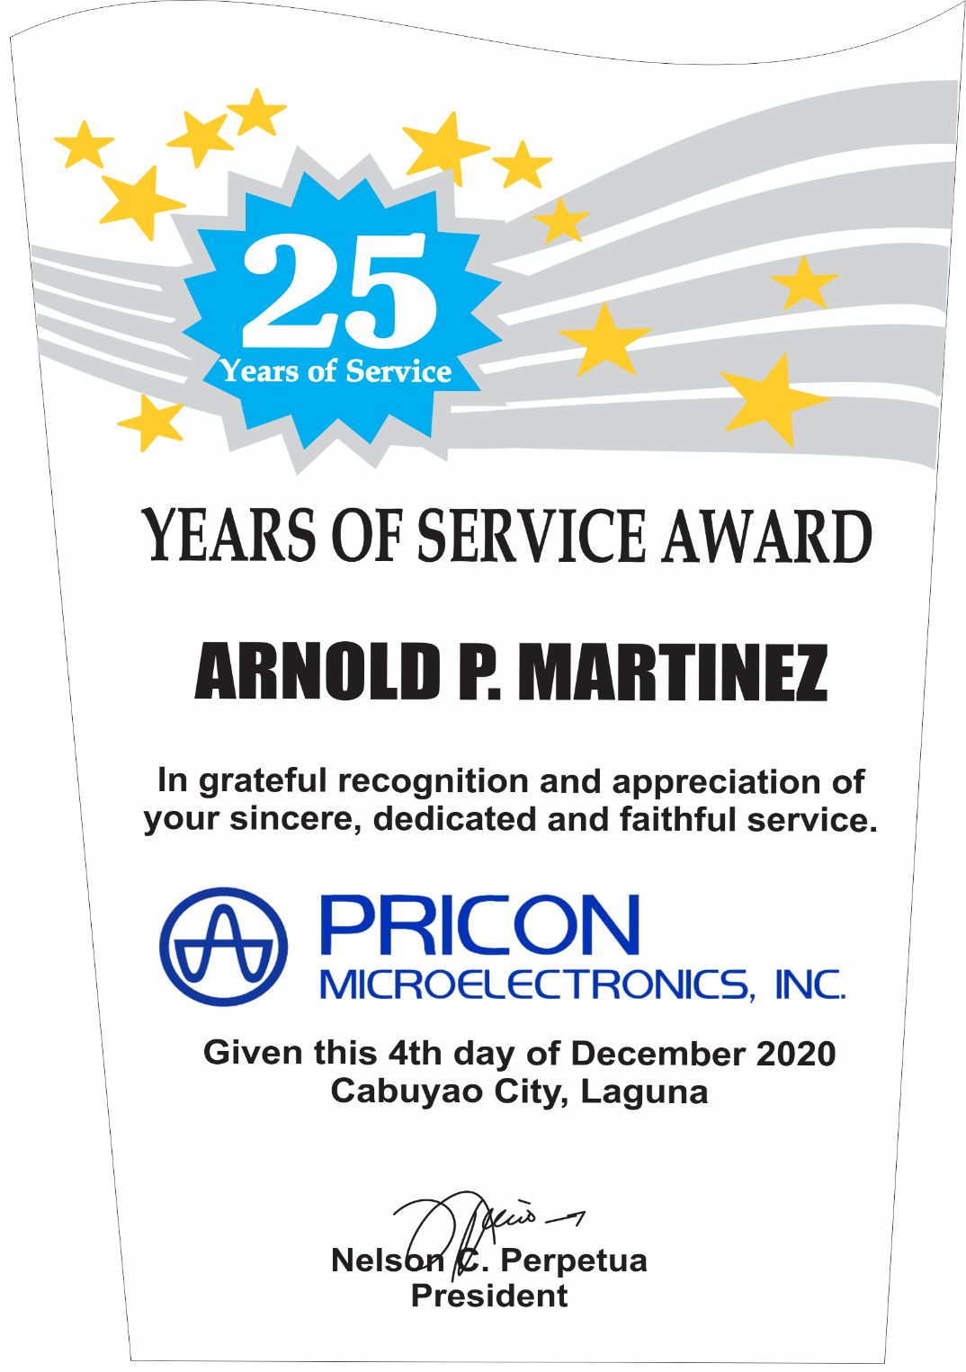
10 inches – Php 1,500/pc
5 Awardees
12 inches – Php 1,800/pc
25 awardees
Marvin I. Cruz
Jochebed S. Bigueja
Given this 6th day of December 2022
Cabuyao City, Laguna
Given this 6th day of December 2022
Cabuyao City, Laguna

Slide 3
Loyalty Awardees
20 years
1 | Medelina D.Palencia
2 | Marvin I.Cruz
3 | Joylyn M.Porcare
4 | Janilyn M. Peña
5 | Michelle G.Ordinario
25 years
1 | Delly F. Amandoron
2 | Leonides B. Dullavin
3 | Jochebed S.Bigueja
4 | Cheryl R.Tanay
5 | Christian A. Palacio
6 | Eloisa S. Saul
7 | Andres S.Ulanday Jr.
8 | Jose V. Lozada Jr
9 | Roger R. Salamia
10 | Delita O. Calleja
11 | Suzeth D. Dalisay
12 | Maria Leonora E. Perez
13 | Fidela O. Bogabil
25 years
14 | Nimfa P. Carungay
15 | Noeme S. Donato
16 | Miguel R. Relano
17 | Shirine E. Soco
18 | Elma A. Palingcod
19 | Jenalyn C. Gamilla
20 | Georgina L. Lopez
21 | Arlyn C. Talagtag
22 | Marites R. Mendoza
23 | Mary Jane P. De Mesa
24 | Rene Ros F. Santos
25 | Gilyn E. Abay

